Slide 1


DATA 1204 – STATISTICAL PRED MODELING
PROFESOR: Fatma Tetikoglu

Slide 2
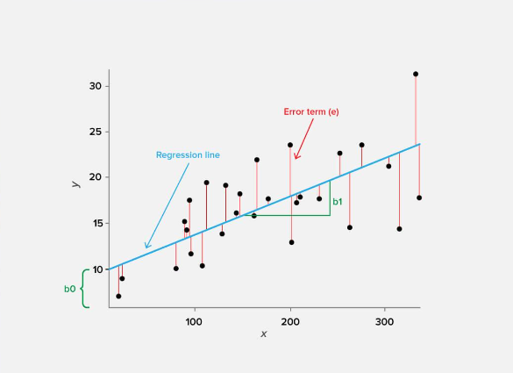
Assignment: 5 Linear Regression
PREPARED BY: Abdulrahman Ramsey Momodu
Student ID: 100864843
Date Submitted: 04/11/2022

Slide 3
PROBLEM STATEMENT
Create a Hypothesis statement based on the assumption that the predictor (or independent) variable for our linear regression will be “dividend” and the dependent variable (the one we’re trying to predict) will be “stock_return_scaled”
a. Summary of your linear regression analysis
b. What insights have you gained from the findings? Please explain your answers
c. What other two (2) variables would you include to help increase the accuracy of your model? Please explain your answers.

Slide 4
We will start by stating the hypothesis statement: Ho: β=0, co-efficient β of the predictor (DIVIDEND is zero and not statistically significant Ha: β ≠0, co-efficient β of the predictor (DIVIDEND) is not equal to zero and is statistically significant Using the ols_stock, we will create the scatter plot to test the relationship between STOCK_RETURN_SCALED(Y-axis) and DIVIDEND (X-axis) We will take the significance level to be 0.05 We will conduct the linear regression analysis using R. Linear Regression works on the assumption that both variables are correlated. We will obtain a p-value to enable us to make a conclusion on the statistical significance of the model t-value, P-value, and f-statistics will enable us to analyze the model from a robust perspective
Summary of Linear Regression

Slide 5
Rational Statement
To test the linearity or normality of the two variables, a scatter plot would be used.
We will use R to perform a Linear Regression analysis to determine the relationship or dependency between DIVIDEND and STOCK RETURN SCALED.
We will draw a conclusion based on the P-value obtained from the linear regression model and compare it to the significant value (0.5) to determine how viable the model is.
Test the hypothesis to know if there is a relationship between DIVIDEND and STOCK RETURN SCALED.
To have a better understanding of how correlated and the linearity between the DIVIDEND and STOCK_RETURN_SCALED a scattered plot will be plotted
We will obtain the p-value to enable us to draw a conclusion

Slide 6
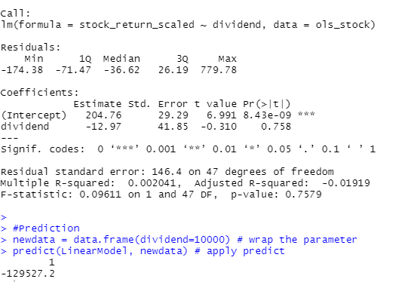
Linear Regression Output Simple Regression Model

Slide 7
Summary – Linear Regression understanding the simple regression model output above
Residuals: The section summarizes the residuals and the error between the model's prediction and the actual results. Lower residuals are preferable.
Coefficients: A weight is generated for each variable and the intercept, and that weight has additional attributes such as the standard error, t-test value, and significance.
Estimate: This is the variable weight. In the simple regression case (one variable plus the intercept), the model predicts an increase of -12.97 for every stock_return_scaled
Std. Error: This value indicates how precisely the estimate was measured. It can only be used to compute the t-value.

Slide 8
Summary – Linear Regression
t-value and Pr (>[t]): The t-value is calculated by dividing the coefficient by the standard error. It is then used to determine whether the coefficient differs significantly from zero. If it's not significant, the coefficient isn't adding anything to the model and should be dropped or investigated further. The significance level is Pr (>|t|).
Performance Measures: Three sets of measurements are provided.
Residual Standard Error: This is the residuals' standard deviation. It is better when is smaller.
Multiple / Adjusted R-Square: For one variable, (the distinction doesn’t matter). R-squared shows the amount of variance explained by the model. Adjusted R-Square considers the number of variables and is most useful for multiple regression.
F-Statistic: The F-test determines whether the weight of at least one variable differs significantly from zero. This is a global test to aid in the evaluation of a model. If the p-value is not significant (e.g., greater than 0.05), your model is essentially useless.

Slide 9
General Insight Hypothesis Testing and Inference
The null and alternate hypothesis
Ho: β=0, co-efficient β of the predictor is zero and not statistically significant
Ha: β ≠0, co-efficient β of the predictor is not equal to zero and is statistically significant
We can use the dataset to investigate how the dividend column affects the outcome column. The dataset indicates that the dividend and stock_return_scaled are categorical data.
The dataset indicates that the dividend is a categorical variable because it contains categorical data (0, 0..n and 1...n). We are attempting to predict a numerical value using a categorical value. Keeping that in mind, I'll move on to the analysis.
The outcomes/results may not be favourable to a positive conclusion. In the following step, we will continue to analyze.

Slide 10
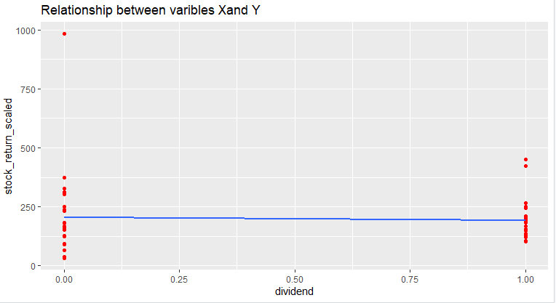
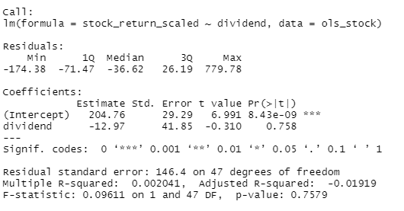
Scattered Plot
what see In the scattered plot is that our independent variable is a categorical variable which consists of only two levels 0 and 1, this might be a problem in our analysis, keeping this in mind, we will continue with our Simple Linear Regression

Slide 11
Insight
The summary statistics presented above tell us several things. The model p-Value (bottom last line) and the p-Values of individual predictor variables (extreme right column under 'Coefficients' are two of them.
The p-Values are extremely important because we can only consider a linear model statistically significant if both p-Values are less than the pre-determined statistical significance level, which is insignificant significance stars at the end of the row visually represent this. The more stars beside it the greater the p-Value of a variable, and the more significant the variable.
The Degree of Freedom (DF)
This represents how many numbers in the grid are truly independent
DF = 47
t-value
The t-value can be interpreted as follows. A higher t-value indicates that the coefficient is less likely to be non-zero by chance. As a result, the higher the t-value, the better. What does this mean for us? When the p Value is less than the level of significance (0.05), we can safely reject the null hypothesis that the coefficient of the predictor is set to zero. Both of these p-Values are well below the 0.05 threshold in our case, so we can conclude that our model is statistically significant.

Slide 12
Reason for Using a linear regression model
Linear regression is used to predict the value of an outcome variable Y based on one or more input predictor variables X. The aim is to establish a linear relationship (using a mathematical formula) between the predictor variable(s) and the response variable, so that, we can use this formula to estimate the value of the response Y, when only the predictors (X…n) values are known.
in this case, we will be predicting the outcome variable Y (stock_return_scaled)
Y = β1 + β2X + ϵ

Slide 13

Y = β1 + β2X + ϵ
Equation for the Regression Model
Y(stock_return_scaled) = 204.76 +(-12.97 )*X(dividend)
Because Stock_Return_Scaled (Y) is a Numerical Variable and the Dividend (X) is a Categorical variable, and also because Y has only two values (0 and 1) with X Values, therefore, we cannot use X to estimate the Y variable
So, for every additional unit of Stock returned scale, there would be a 191.03(204.76-12.97) unit increase in dividend
RELATIONSHIP BETWEEN X and Y
The result from the F-statistics shows that there is no relationship between X and Y. The scattered plot also shows a better view between X and Y ( there is no correlation between these two variables)

Slide 14
Recall of Null hypothesis
The null and alternate hypothesis
Ho: β=0, co-efficient β of the predictor is zero and not statistically significant
Ha: β ≠0, co-efficient β of the predictor is not equal to zero and is statistically significant
Confidence Level = 0.95
Significant level = 0.5
and
P-value = 0.75
Because the P-value (0.75) is significantly greater than the significant level (0.05), we fail to reject the Null hypothesis that state that the predictor's co-efficient β is zero and not statistically significant.
Therefore, we have enough to support the null hypothesis that the model is not significantly significant

Slide 15
What other two (2) variables would you include to help increase the accuracy of your model? Please explain your answers.
From my analysis, it shows that the dividend is not a good predictor, we could not estimate the Y using X, therefore, there will need to improve the accuracy because the dividend is not a good predictor.
The other two variables that we can include to improve the accuracy are
debt_to_equity
marketcap
These two variables will help to improve the curacy because they are numerical, and there will be correlation and linearity between the variables

Slide 16
library(readxl) ols_stock <- read_excel("C:/Users/Ramsey Abdul/Downloads/ols_stock.xls") View(ols_stock) #load Libraries library(ggplot2) library(dplyr) #Dataset Review str(ols_stock) ggplot(ols_stock, aes(x = dividend, y = stock_return_scaled))+ geom_point(colour = "red") + geom_smooth(method = "lm", fill = NA) + labs(title = "Original Model", x = "dividend", y = "stock_return_scaled") #Simple regression model simple.fit<-lm(stock_return_scaled~dividend, data=ols_stock) LinearModel<-simple.fit summary(LinearModel) #Prediction newdata = data.frame(dividend=10000) # wrap the parameter predict(LinearModel, newdata) # apply predict
Code Script

Slide 17
Tetikoglu F. (2022). Lecture Note, Week 12 – Linear Regression Part II

Slide 18
Thank you

